Slide 1
self-attention
Prepare inputs
Initialize weights
Derive key, query and value
Calculate attention scores for Input 1
Calculate softmax
Multiply scores with values
Sum weighted values to get Output 1
Repeat steps 4–7 for Input 2 & Input 3

Slide 2
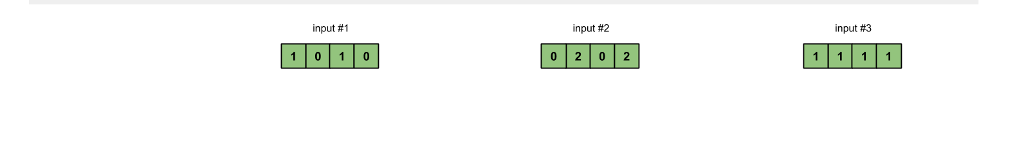
Prepare inputs
3 inputs, each with dimension 4
dimension n
Notes:
확연히 다른 두 문장이 한문장으로 → 앞부분이 뒷부분으로 해석됨 (예시?)

Slide 3
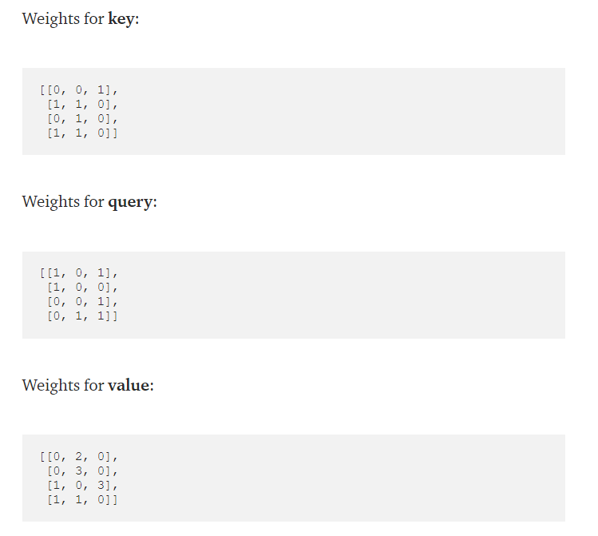
Initialize weights
Small number
Initialized randomly
nxm
Notes:
[1 0 1 0 ] [

Slide 4
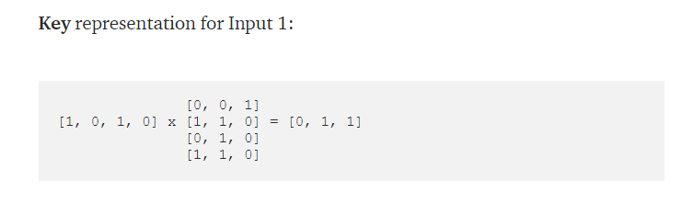
Derive key, query and value
Weights for key
Input 1
Key for input 1
m

Slide 5
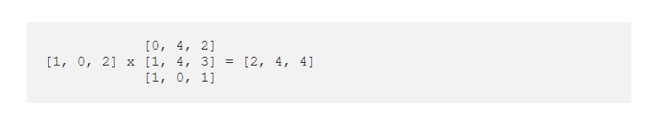
Calculate attention scores for Input 1
Key for input 1
Key for input 3
Query for input 1
scores from input 1 to 3
Key for input 2
Notes:
[2, 4, 4]
2: input1 & input1 관련성
4: input1 & input2 관련성
4: input1 & input3 관련성
숫자가 높으면 → 관련성이 ??? (높/낮)

Slide 6
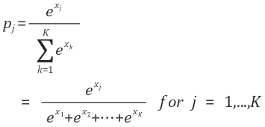
softmax

Slide 7
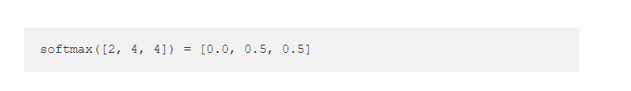
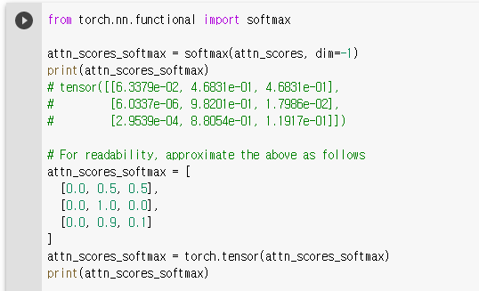
Calculate softmax
Notes:
Softmax function → dim?
[0.0, 0.5, 0.5] input 1의 softmax(attention score)
[0.0 1.0 0.0] input 2의 softmax(attention score)
[0.0 0.9 0.1] input 3의 softmax(attention score)

Slide 8
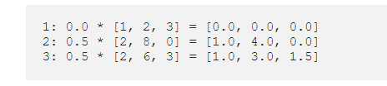
Multiply scores with values
Values from input 1 to input 3
Softmax of scores
Weighted values

Slide 9
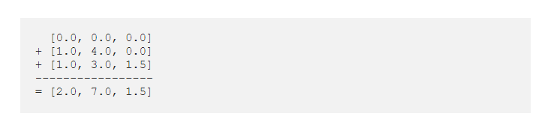
Sum weighted values to get Output 1
Weighted values
Output 1

Slide 10
Repeat steps 4–7 for Input 2 & Input 3

